Slide 2
Act 1. Scene 1

Slide 3

两个老头密谋打赌的场景 找不到合适的☹

Slide 5
Act 1. Scene 2

Slide 6
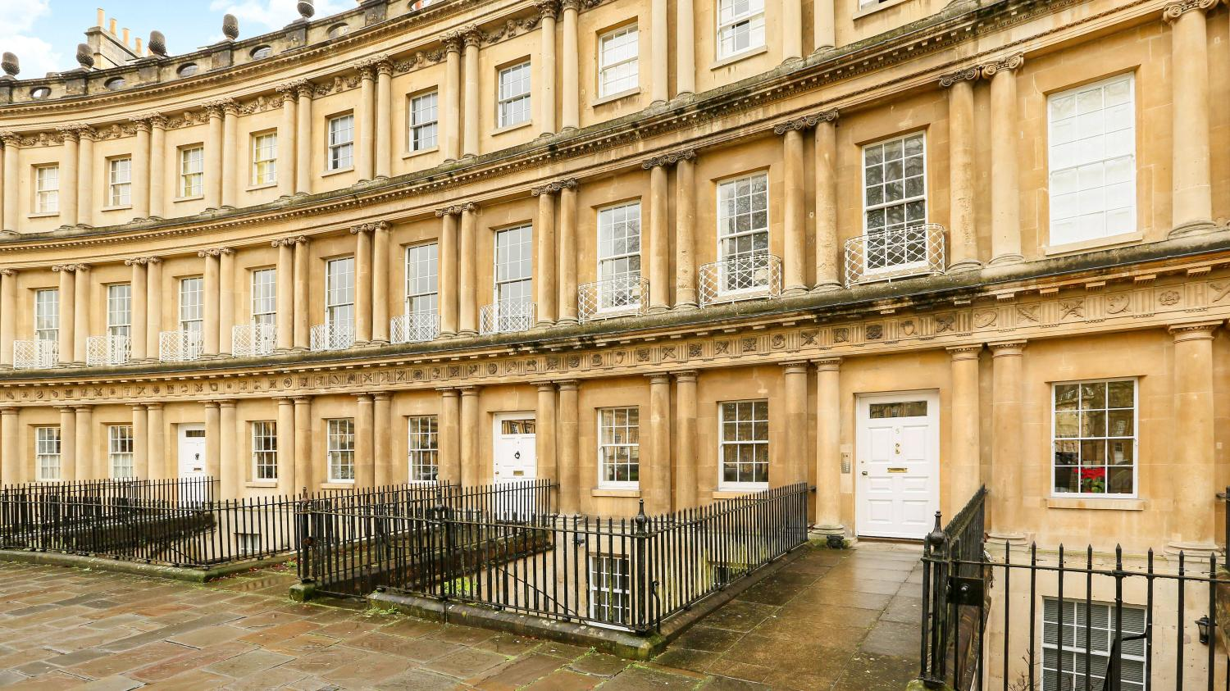

Slide 7


The enclosed Bank Note is lent to you for one month. If you return it intact at the end of that time, you shall have any job that is within our power to give you. It may interest you to know that we have a bet on you.
两个老头密谋打赌的场景 找不到合适的☹

Slide 9
Act 2

Slide 10


Slide 11
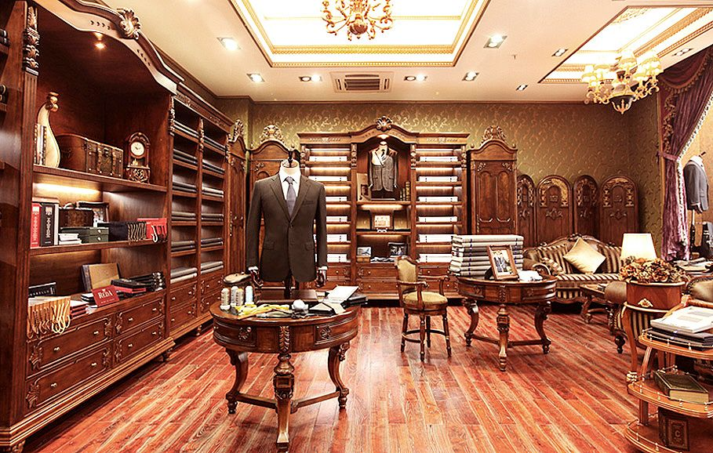

Slide 13
Act 3

Slide 14


Slide 16
Act 4

Slide 17


Slide 19
Act 5. Scene 1

Slide 20


Slide 21


Slide 23
Act 5. Scene 2

Slide 24
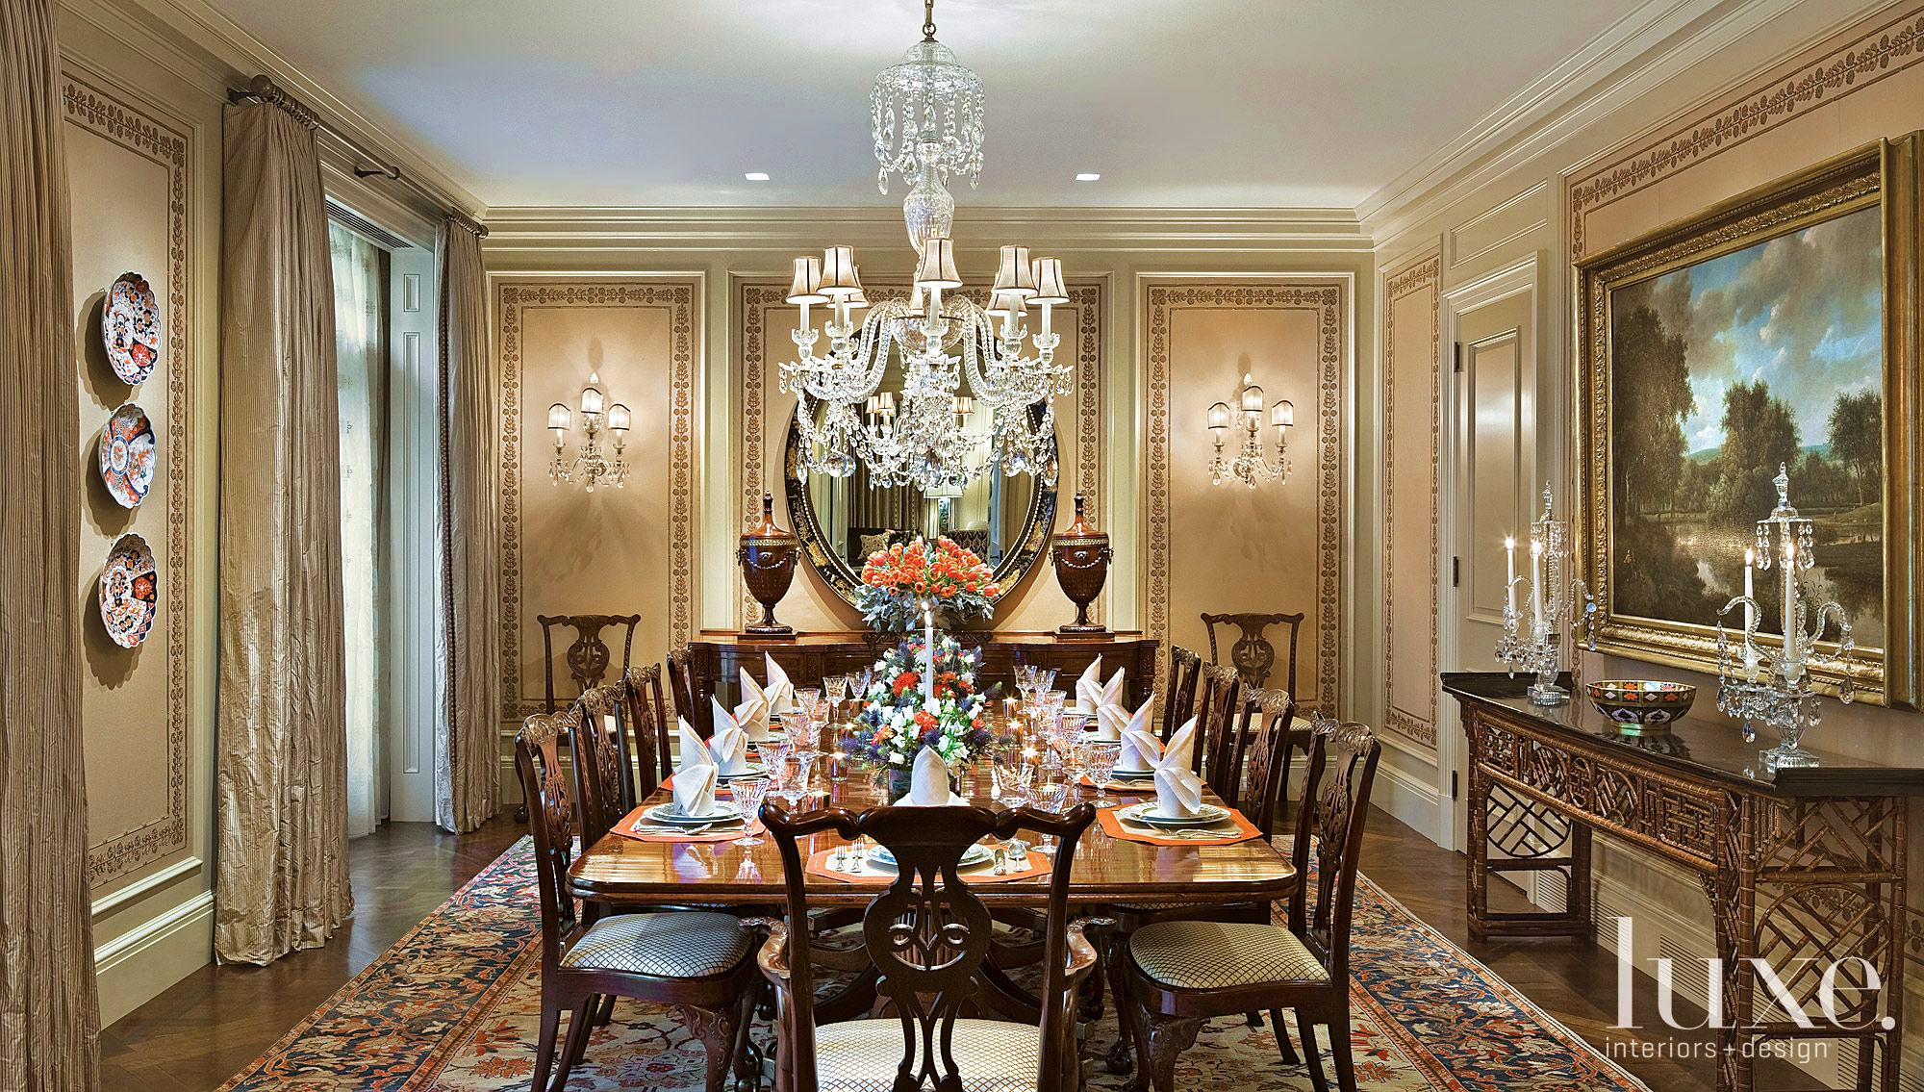

Slide 25


Slide 28
Act 5. Scene 3

Slide 29
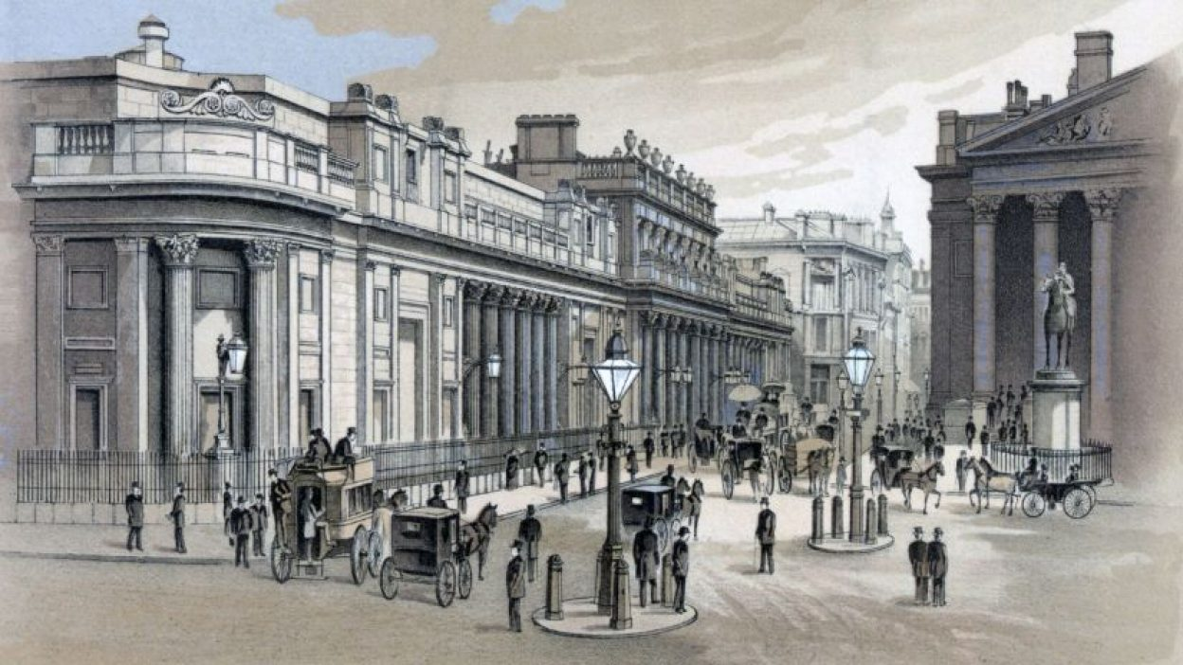
London Stock Exchange

Slide 31
Act 6

Slide 32
两个老头密谋打赌的场景 找不到合适的☹

